Slide 1
B.Tech. Major Project -
Channel Estimation in MIMO OFDM System in 5G using Deep Learning
Under Supervision of Prof. Purnendu Karmakar-
Aniket Tiwary - 17uec020
Aditya Raj - 17uec143
Yash Maheshwari - 17uec146

Slide 2
Table of Content
Problem Statement
Introduction
Understanding the code and project flow
Results
Future scope
Acknowledgement

Slide 3
Problem Statement
?
Minimization of channel estimation error using Deep learning Technique for MIMO OFDM 5G system.

Slide 4
Introductions
01
We understand the basics of MIMO OFDM systems in brief.
02
Gaining insights in other theoretical concept like Cyclic prefix, LSE,MMSE,Pilots,etc
03
Understanding various Estimation Techniques and Deep Learning Concept.

Slide 5
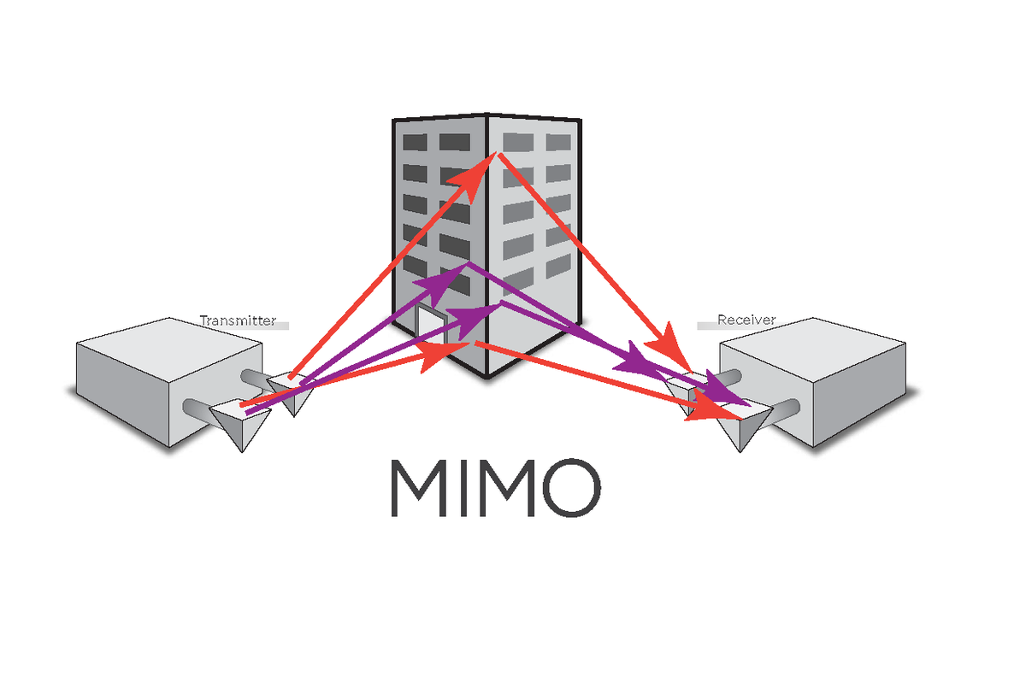
MIMO OFDM
Multiple Input Multiple Output(MIMO) system is an antenna technology for wireless communications in which multiple antennas are used at both the source (transmitter) and the destination (receiver).
Orthogonal frequency-division multiplexing (OFDM) is a method of digital signal modulation in which a single data stream is split across several separate narrowband channels at different frequencies.

Slide 6
Theoretical concepts
LSE
MMSE
Pilot
CP
Least Square Error Estimator
Minimum Mean Square Error Estimator
Pilot signal Addition
Cyclic Prefix
Minimising the Euclidean square distance between the transmitted and received signal
Comb type pilot signal is periodically added for channel clearance and control purpose.
Cyclic Prefix acts as a buffer that prevents OFDM signal from ISI and ICI or IBI.
Applies the channel statistics to minimise the MSE
Easy to implement
Less Complex
More MSE
Difficult to implement
More Complex
Less MSE
Added to Tx and Rx
Comb type in frequency domain
Periodically added
Cyclic Prefix can remove the frequency selective nature of OFDM and change into FLAT FADING.
Length of the cyclic prefix can be varied

Slide 7
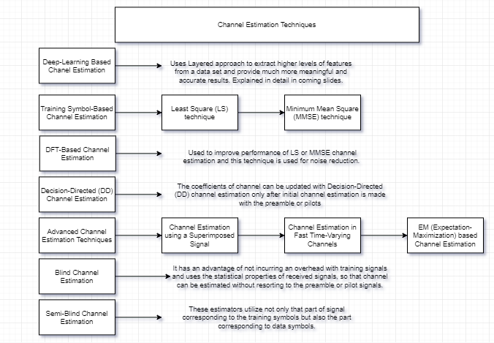
Understanding Various Estimation Techniques

Slide 8
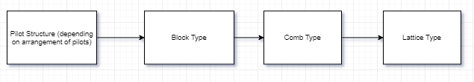
Understanding Various Estimation Techniques
In this project, so far we’ve implemented Channel Estimation based on Block Type Pilot arrangement where we’ve performed estimation using LS (Least Square) estimator and MMSE (Minimum Mean Square Estimator) which comes under Training Symbol-based channel estimation technique. For LS estimation we’ve used Linear Interpolation.
Further, in the next phase of this project, we will be using Deep Learning technique as it provides result better than other traditional estimators which is explained in the next slide.

Slide 9
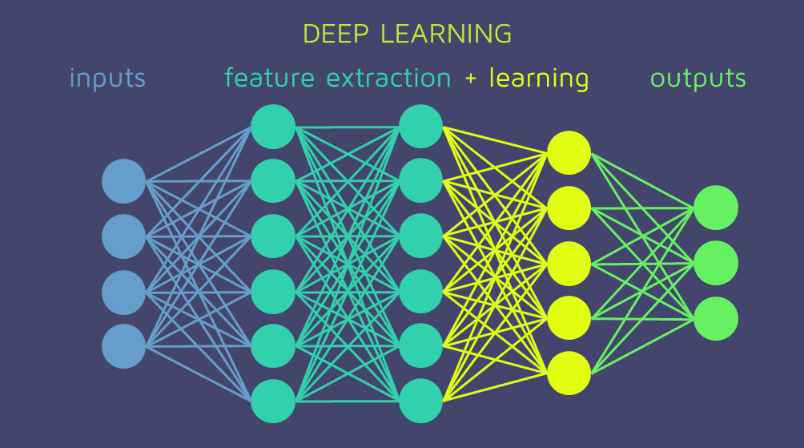
Deep Learning Concepts
Deep learning algorithms use layered approach to extract higher levels of features from a dataset and provide much more meaningful and accurate results. It takes the help of a mesh of neural networks to do so.
In case of Channel estimation problem, It is evident that DL will provide better results as it can combat channel distortions, interferences and better detect transmitted symbols. Generally observed is an approach of using less pilots for neural networks.
Training data can be generated from simulation results of channel estimation and then it can be used to test data and with optimisation of algorithms, it can provide results comparable or better than traditional estimators like LSE, MMSe.

Slide 10
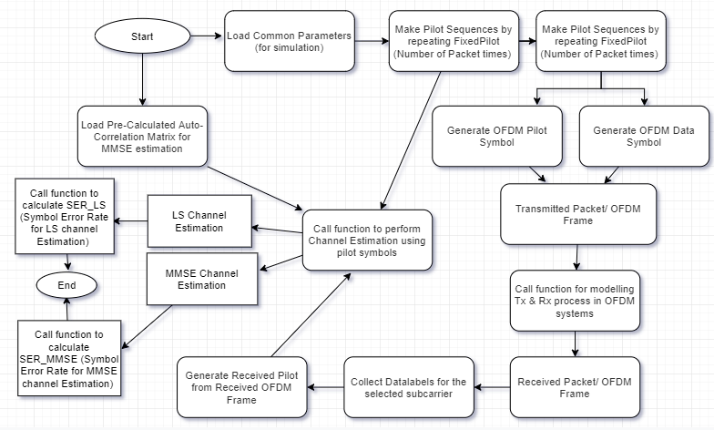
Code Flow

Slide 11
Understanding Code Flow
As can be seen from the code flow, we have called three functions in order to achieve our desired result. These functions serve the following purpose:
Function-1: for modelling Transmission and Receiver process in OFDM systems.
Function-2: for performing LSE and MMSE channel estimation.
Function-3: for calculating SER (Symbol Error Rate) of LSE and MMSE channel estimation.
In next few slides we present a code flow for these functions...

Slide 12
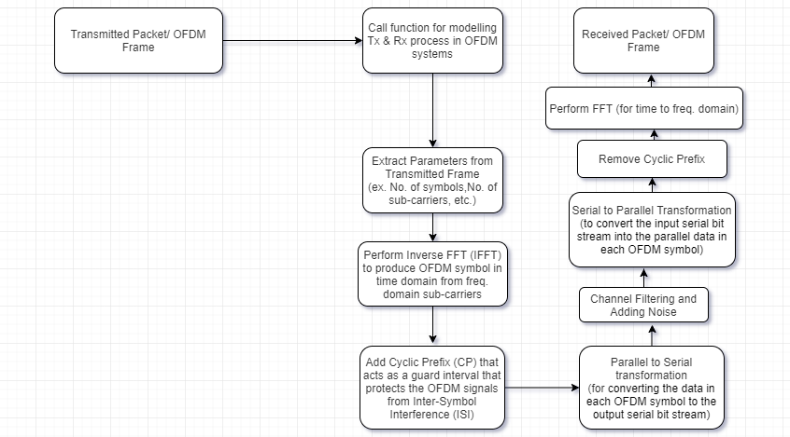
Function-1 (for modelling Tx and Rx process in OFDM systems).

Slide 13
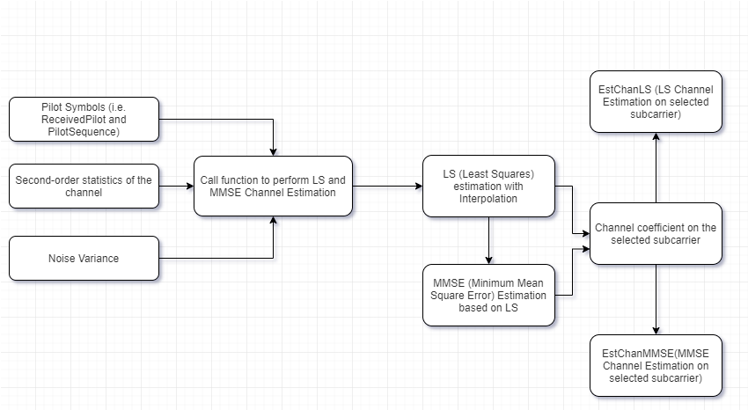
Function-2 (for performing LSE and MMSE channel estimation)

Slide 14
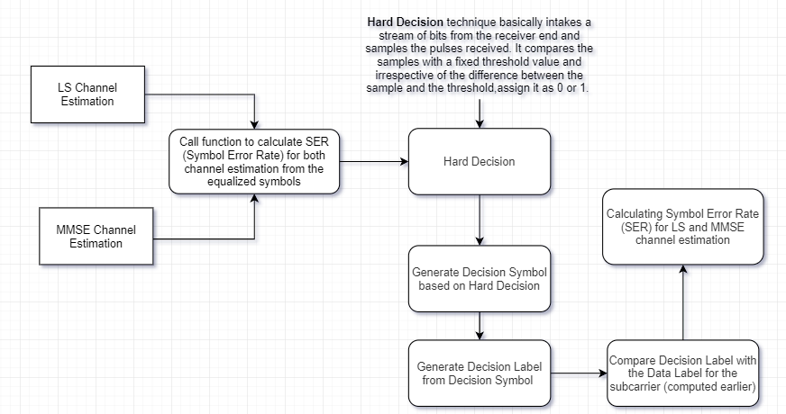
Function-3 (for calculating SER of LSE and MMSE channel estimation)

Slide 15
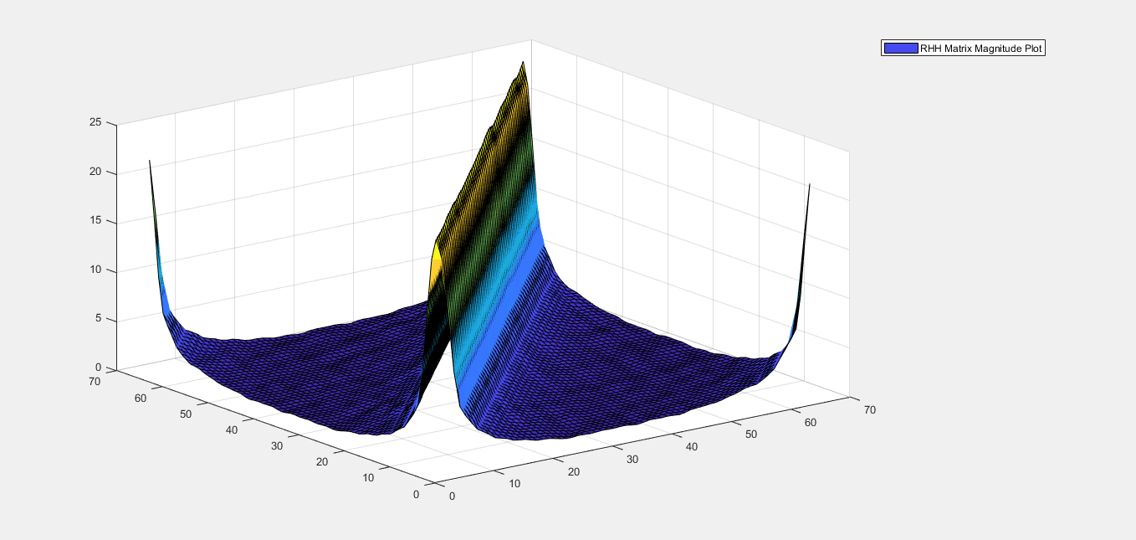
Results
Auto-Covariance of the channel frequency response

Slide 16
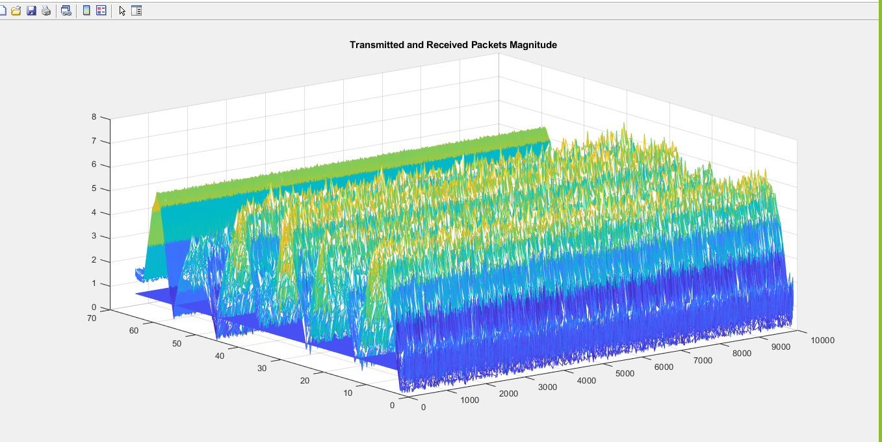
Results
Transmitted and Received packets Magnitude

Slide 17
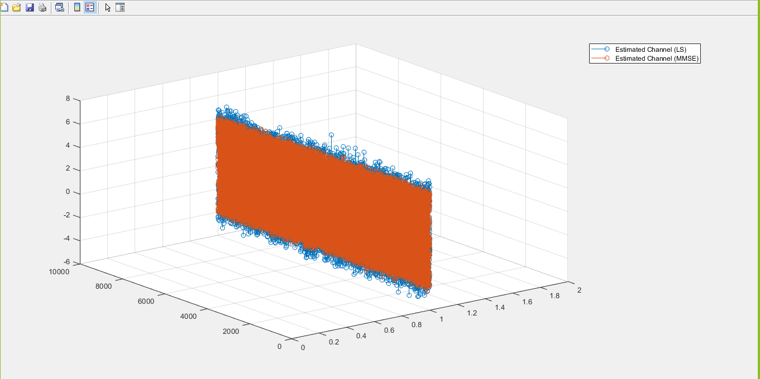
Results
3D plot of Channel Estimation in LS and MMSE

Slide 18
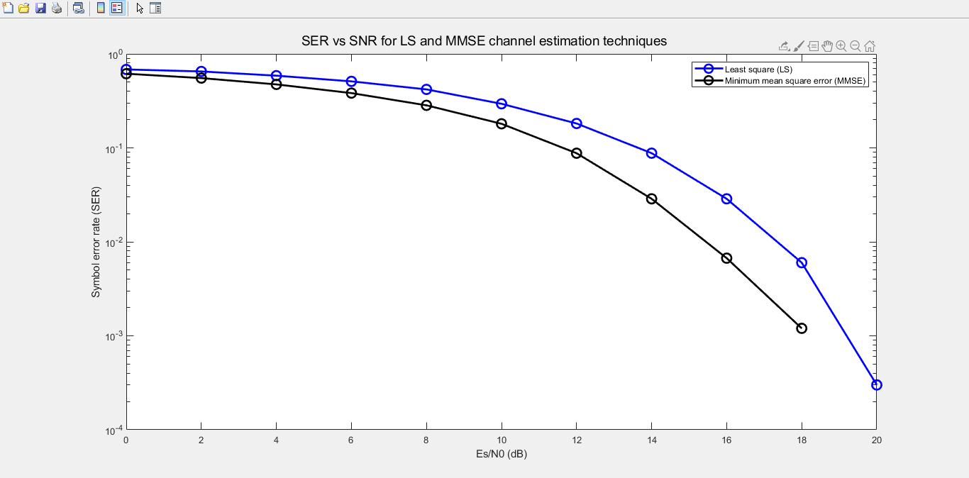
Results
Channel Estimation Plot of LS and MMSE

Slide 19
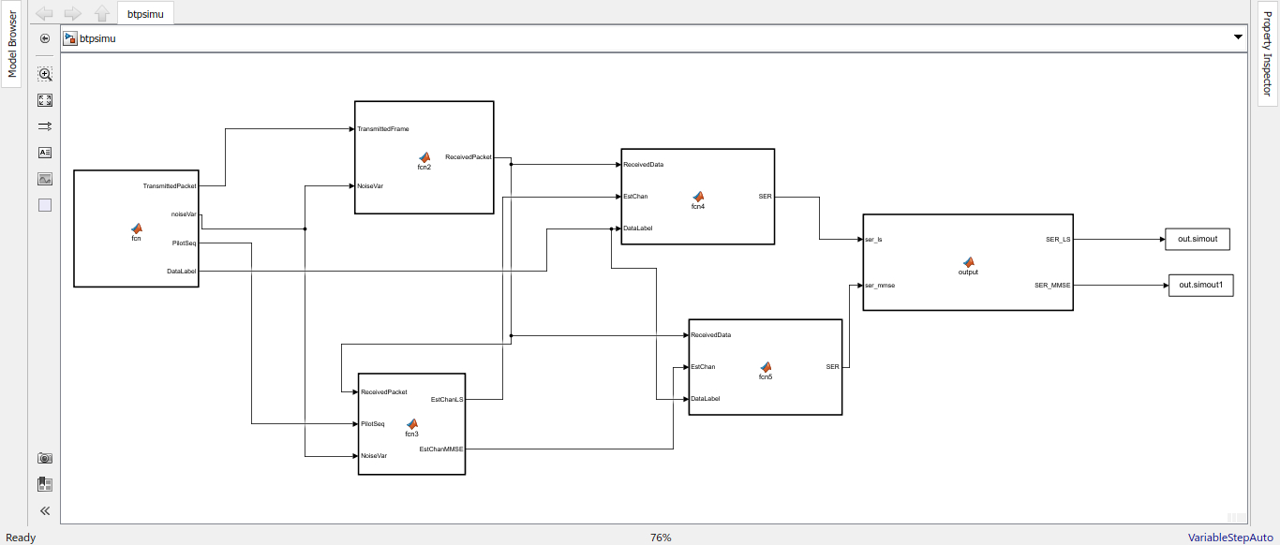
Simulink Model

Slide 20
Project flow
04
Understanding Concept
Deep Learning Estimation
Theoretical and mathematical abstractions
Employ DL for better estimations and results.
01
03
MATLAB/ Python Coding
Simulink Implementation
Implementing in python or MATLAB
In MATLAB create a Simulink Model
02

Slide 21
Future Scope
The project is limited to MMSE and LSE estimators. Further is coded in MATLAB.
We have been in correspondence with Mr. Rahul Makkar for sorting errors in Simulink Model.
We were able to create a MIMO OFDM model in python and modulate, demodulate signals.
Furthermore techniques like Deep learning models can be used for better results

Slide 22

Acknowledgement
We would like to take this opportunity to thank our Mentor Prof. Purnendu Karmakar for his guidance and support
We also thank Mr. Rahul Makkar for his help with the project.
Finally to us,the team members whose cooperation and hard work has made this Term paper a success.

